Slide 1



















PHP = PHunctional
Programming
Luis Atencio
Guidebook app: NEPHP2016

Slide 2
PHP = PHunctional Programming
By Luis Atencio (@luijar)
Northeast PHP Conference 2016

Slide 3
What? Functional... PHP?
Notes:
Didn’t we just become fully OO with 5.3?
Functional Programming is the extensive use of functions to move the application from one state to the next

Slide 4
Agenda
Understand the FP stuff
Function composition and declarative coding
Currying
Functors
Monads
Cool FP libs for PHP
Notes:
Objective: Understand PHP bettter

Slide 5
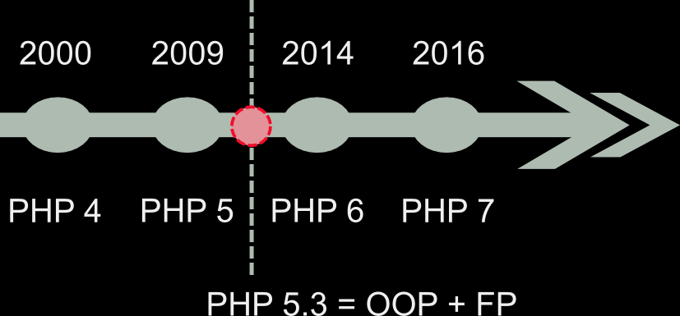

Slide 6
PHP functions became instances of Closure
Notes:
This gives rise to HO functions. Since objects can be passed around and returned

Slide 7
Mathematical-like computing
The birth of the anonymous function!
ƛx.x + 1
(ƛx.x + 1)3 = 4
(ƛx.x + 1)((ƛy.y + 2))3 = 6
Notes:
Everything can be represented in the context of lambda expressions
In school, we’re taught about Turing machines and Von Neumann Model

Slide 8
What did we learn from the Maths?
Pure Functions
No side effects!
Clear contracts input and output
Self-documenting
Stateless
Immutability
Can’t change the contents of something once it’s been initialized
Higher-order functions
Pass functions into other functions
Return functions from other functions

Slide 9
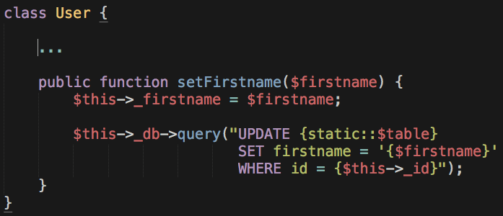
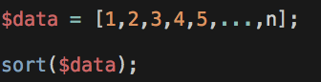
What is a side effect?
A function execution that impacts its outer scope. The effect is more
detrimental when it’s the global scope
Notes:
Pure functions: count.
Exceptions are thrown, printing to the console
Is time() a pure function?

Slide 10
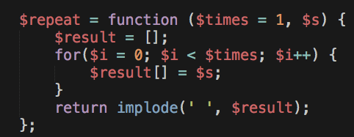
Pure Functions
A function without side effects that returns the same result on
same input
Notes:
Pure functions: count.
Is time() a pure function?

Slide 11
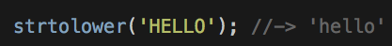
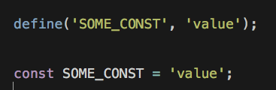
Immutability
Look at immutability through the consistent (repeatable) execution of pure functions
Most bugs originate from data issues
Functions are (represent) immutable values
Very limited support in PHP
Notes:
const cannot be used to conditionally define constants. To define a global constant, it has to be used in the outermost scope:
if (...) { const FOO = 'BAR'; // invalid } // but if (...) { define('FOO', 'BAR'); // valid }
const accepts a static scalar (number, string or other constant like true, false, null, __FILE__), whereas define() takes any expression. Since PHP 5.6 constant expressions are allowed in const as well:
const BIT_5 = 1 << 5; // valid since PHP 5.6, invalid previously define('BIT_5', 1 << 5); // always valid
const takes a plain constant name, whereas define() accepts any expression as name. This allows to do things like this:
for ($i = 0; $i < 32; ++$i) { define('BIT_' . $i, 1 << $i); }
consts are always case sensitive, whereas define() allows you to define case insensitive constants by passing true as the third argument
const simply reads nicer. It's a language construct instead of a function and also is consistent with how you define constants in classes.
const defines a constant in the current namespace, while define() has to be passed the full namespace name:
namespace A\B\C; // To define the constant A\B\C\FOO: const FOO = 'BAR'; define('A\B\C\FOO', 'BAR');
Since PHP 5.6 const constants can also be arrays, while define() does not support arrays yet. However arrays will be supported for both cases in PHP 7.
const FOO = [1, 2, 3]; // valid in PHP 5.6 define('FOO', [1, 2, 3]); // invalid in PHP 5.6, valid in PHP 7.0
As consts are language constructs and defined at compile time they are a bit faster than define()s.

Slide 12
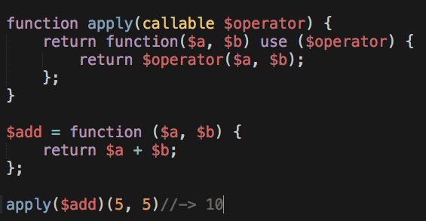
Higher-order functions
Pass functions to other functions
Return functions from other functions
Lazy evaluation

Slide 13
Variable functions
If a variable has parenthesis appended to it, PHP will try to invoke it
Can be passed in by name (string) or reference
Will not work with language constructs:
echo
print
unset
isset
empty

Slide 14
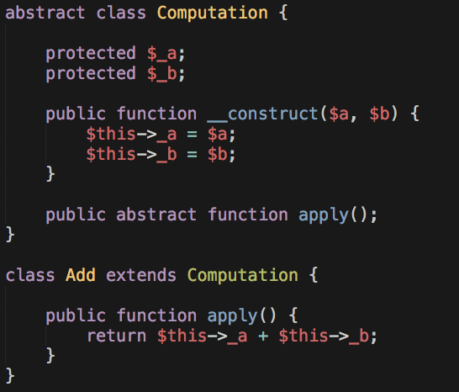
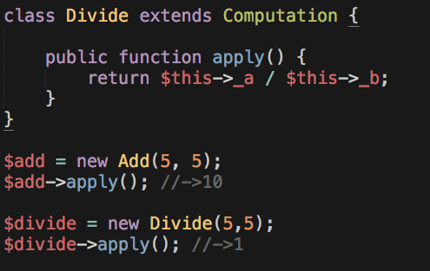
Composition vs Inheritance
Notes:
Adding a new strategy involves creating a new class. Ex. safeDivide

Slide 15
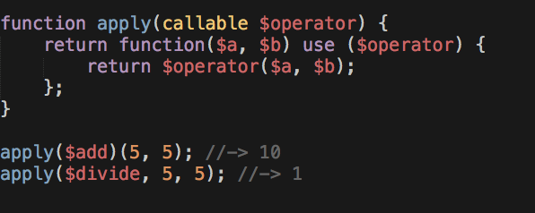
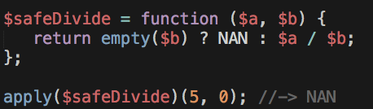
Composition vs Inheritance₂
Adding new behavior is easy
Notes:
FP makes patterns disappear

Slide 16
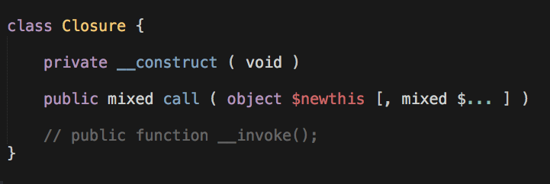
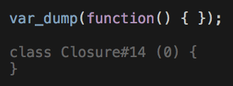
Functions are first-class in PHP
The Closure class was added in PHP 5.3.0

Slide 17
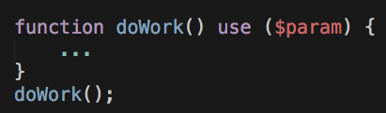
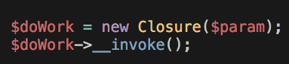
Everything is an object under the hood
Syntactic Sugar

Slide 18
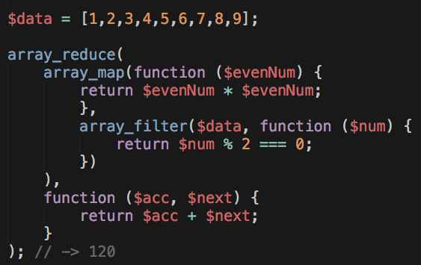
Towards more functional code
PHP 4.0.6 introduced (but they are not pure!) to eliminate looping!
array_map()
array_filter()
array_reduce()
Notes:
No consistent API
Cumbersome and verbose to use
No currying
Not immutable!
They separate the loop away from your business logic

Slide 19
Application State: OO
In OO you move state by passing objects around and invoking
methods on those objects. In FP you pass state to the functions and
combine them to move/transform it.
ObjectC
ObjectA
ObjectD
ObjectB

Slide 20
Application State: FP
In FP you pass state to the functions and combine them to
move/transform it.
FuncC
FuncA
FuncD
FuncB

Slide 21
FP vs OO
Functions vs Objects
Stateless vs Stateful
Declarative vs Imperative
Mutable vs Immutable
Notes:
This gives rise to HO functions. Since objects can be passed around and returned

Slide 22
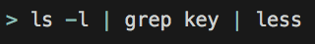
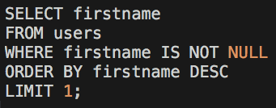
Declarative
Describe WHAT a program does
Not HOW to do it
Unix pipeline
SQL
Notes:
How to do it we let the compiler worry abo
Variable functions ¶
PHP supports the concept of variable functions. This means that if a variable name has parentheses appended to it, PHP will look for a function with the same name as whatever the variable evaluates to, and will attempt to execute it. Among other things, this can be used to implement callbacks, function tables, and so forth.
Variable functions won't work with language constructs such as echo, print, unset(), isset(), empty(), include,require and the like. Utilize wrapper functions to make use of any of these constructs as variable functions.

Slide 23
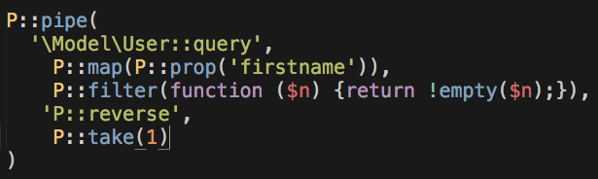
Declarative₂
Using PRamda Functional PHP Library
https://github.com/kapolos/pramda
Notes:
How to do it we let the compiler worry abo
Variable functions ¶
PHP supports the concept of variable functions. This means that if a variable name has parentheses appended to it, PHP will look for a function with the same name as whatever the variable evaluates to, and will attempt to execute it. Among other things, this can be used to implement callbacks, function tables, and so forth.
Variable functions won't work with language constructs such as echo, print, unset(), isset(), empty(), include,require and the like. Utilize wrapper functions to make use of any of these constructs as variable functions.

Slide 24
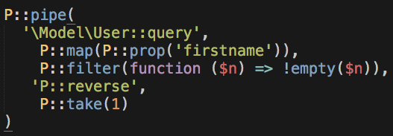
Lambda Expressions
Arrow functions RFC under discussion
https://wiki.php.net/rfc/arrow_functions
Notes:
How to do it we let the compiler worry abo
Variable functions ¶
PHP supports the concept of variable functions. This means that if a variable name has parentheses appended to it, PHP will look for a function with the same name as whatever the variable evaluates to, and will attempt to execute it. Among other things, this can be used to implement callbacks, function tables, and so forth.
Variable functions won't work with language constructs such as echo, print, unset(), isset(), empty(), include,require and the like. Utilize wrapper functions to make use of any of these constructs as variable functions.

Slide 25
Function composition Declarative style + modularity
Notes:
This gives rise to HO functions. Since objects can be passed around and returned

Slide 26
Function composition
The composition of functions f and g is another function that takes the result of g and pass it to f:
f _{o} g = f( g(x) )
B -> C
A -> B
Output: C
f
B
g
Input: A

Slide 27
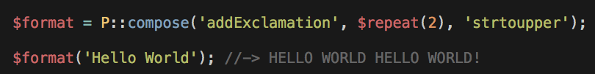
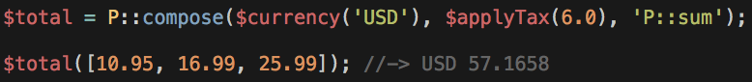
Function composition₂
Examples:

Slide 28
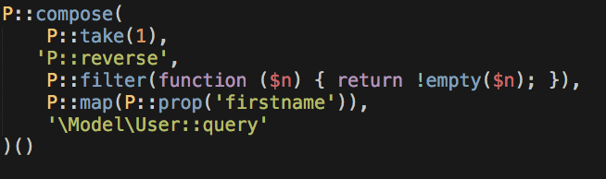
Function composition₃
It’s just the inverse of PIPE!
Point-free style!
Notes:
This is also known as point-free style

Slide 29
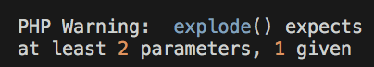
Currying
Composition requires we use single argument functions
Partially evaluate a function as a sequence of steps providing one
argument at a time
PHP uses eager function evaluation
function f(a, b) { … }
evaluating:
returns:
f
(
a
)
Notes:
We can do this thanks to HO functions

Slide 30
Currying₂
Transforms a multi-argument function into several single-arity functions
function f(a, b) { … }
curry(f) = function (a, b) {
return function (a) {
return function (b) {
...
}
}
}
wait to be invoked

Slide 31
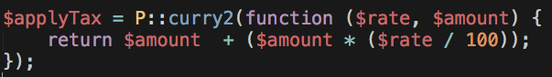
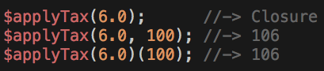
Currying₃
Example:

Slide 32
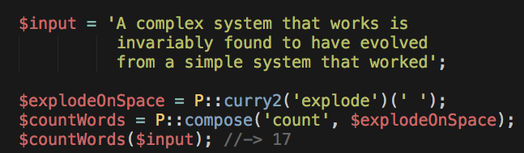
Currying + Composition
Example:

Slide 33
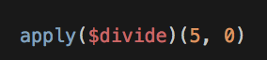
What about errors?
Notes:
This gives rise to HO functions. Since objects can be passed around and returned

Slide 34
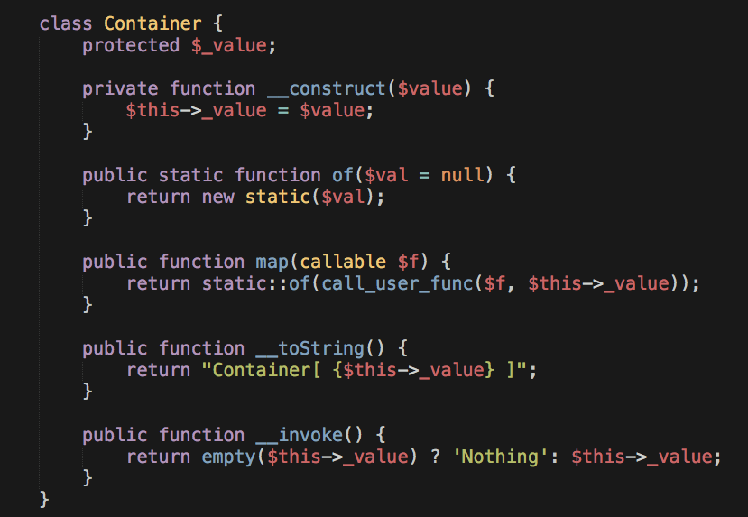
Map-able container

Slide 35
Containers are not new
Generalization

Slide 36
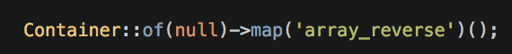
Protecting access to data
?
Notes:
Most errors are due to error in the data

Slide 37
Mapping a value to a container
Map function
HELLO
strtolower
wrap
Container
HELLO
hello
HELLO
Lift
This is known as a Functor!!
Notes:
This is a functor

Slide 38
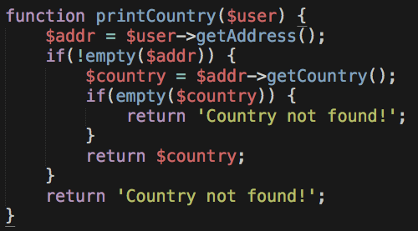
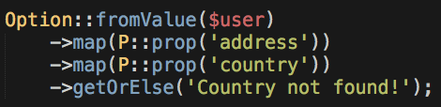
Option Type
Intended for cases when you might want to return a value—like an
object, or (optionally) not—like null.
vs
https://github.com/schmittjoh/php-option
Notes:
You are documenting the fact that you’re using this type
Option is a monad!

Slide 39


Reactive Programming
Notes:
Didn’t we just become fully OO with 5.3?

Slide 40
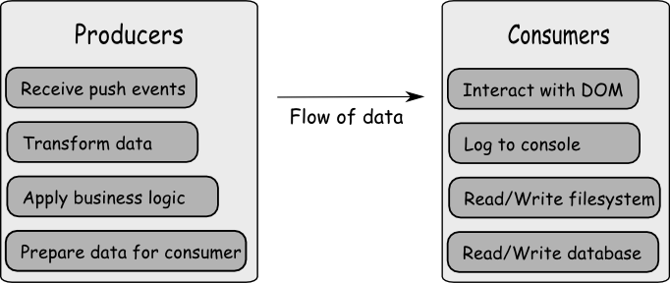
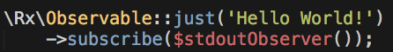
The Observable type
Treat any type of data (of any size) as a composable stream. Makes
use of the Observer pattern

Slide 41
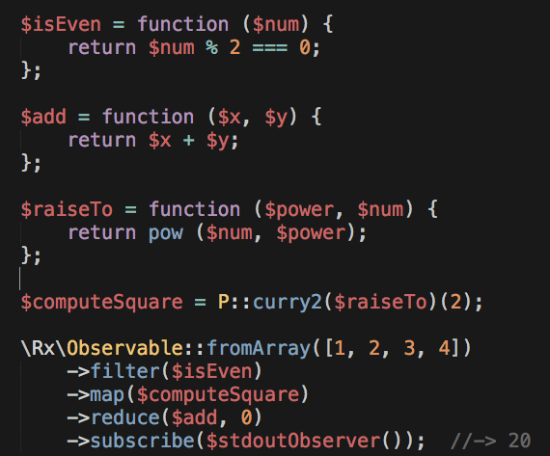
More observables
Business
Logic
Orchestrate

Slide 42
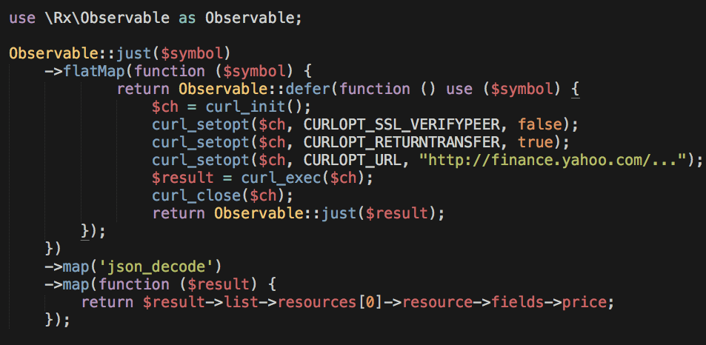
Functional, Async computing
https://github.com/ReactiveX/RxPHP

Slide 43
Conclusion
“..FP in the small... OO in the large...”
- Michael Feathers
PHP = FP + OO

Slide 44
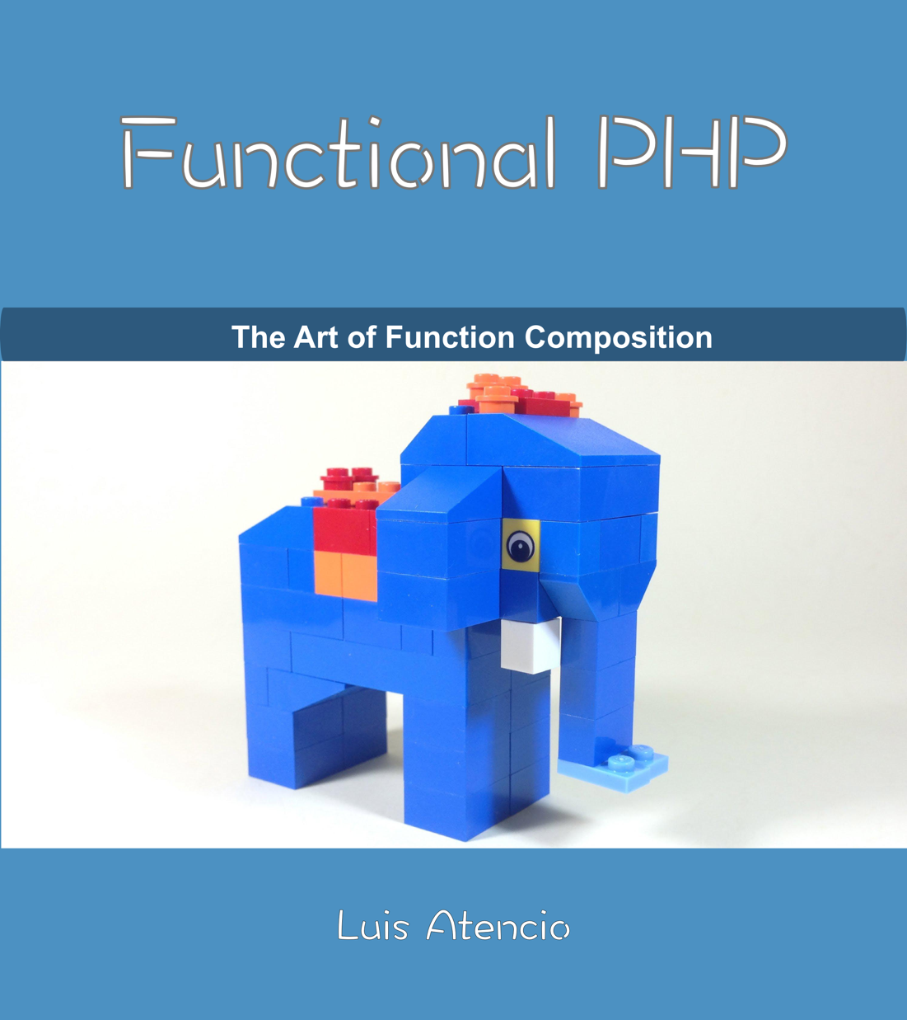
Functional PHP
Resource
https://leanpub.com/functional-php
Free to read!!!

Slide 45
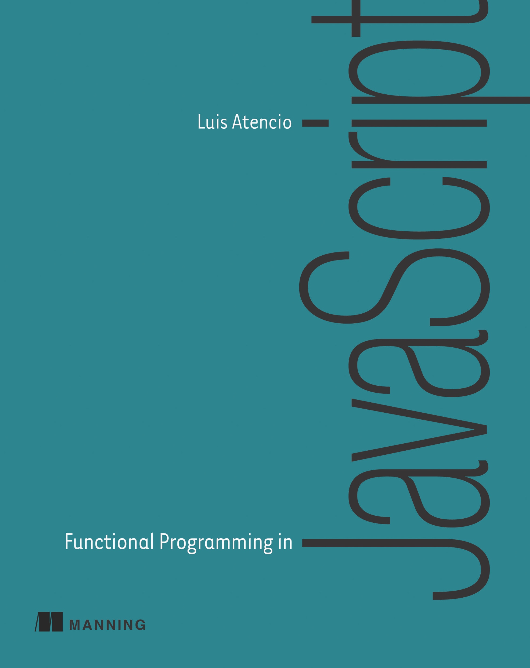
Functional Programming in JavaScript
Resource
https://www.manning.com/atencio
Get on Amazon

Slide 46

RxJS in Action
Resource
https://www.manning.com/books
/rxjs-in-action
Get on Manning.com

Slide 47
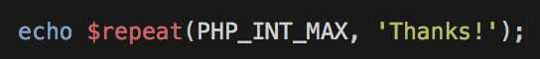
@luijar

